Slide 1
Module 5 Part 2
RFP
PMBOK

Slide 2
Request for Proposal
Excerpts from
https://www.smartsheet.com/request-for-proposal

Slide 3
Request for Proposal
A request for proposal (RFP) is a formal document that an organization uses when it wants to buy a product or service.
A company publishes the RFP that includes a detailed explanation of what you want and why, and uses it to solicit bids and identify the best partner in developing the product.
It is a competitive process in which several companies may submit proposals.

Slide 4
Content of RFP
The RFP outlines what your organization is looking for and how it will evaluate proposals. It typically includes information in the following categories:
Technical: Describe the business objectives of the project and details about the scope of the project including development, standards, outcomes, and deliverables.
Administrative: Provide information about the company issuing the RFP, including its history, organization, and operations.
Financial: Outline information about the company's business plan, financial data, and risk analysis.

Slide 5
Reasons for Issuing an RFP
The RFP process is thorough and time-consuming.
When funding is available for major initiatives or business goals, companies invest the resources to develop, write, and issue an RFP.
The document makes a statement about who you are as a company and where you want to head.
It is especially helpful if, as a company, you are looking for the best way to create a product or service that doesn't currently exist.
By definition, you use an RFP when you want to buy a product, but you also use it to announce that, through this competitive process, you want to find the right partner.
You also create an RFP to foster an open and transparent process for finding the best solution. It shows you are serious about your business and expect potential partners to offer thoughtful solutions.

Slide 6
RFP : How does it work?
Describes the details of the project or service.
Announces that you are looking for a wide range of vendors to provide their best ideas, solutions, and price in a bidding process.
if created and distributed early in the product development cycle, the bidders may demonstrate how they will implement your project.
can reveal your business and negotiation strategy
Are you looking for a one-time vendor who can offer a solution to your project, or do you prefer a long-term partner in a range of products that would flow from this initial project?
whether there are existing vendors that have developed work for you in the past who may already have the expertise required for this project.

Slide 7
RFP : How does it work?
ensures you will have a clearly defined set of responses that fit the scope of the project that you can asses impartially and without bias.
it helps you identify whether the companies responding to your RFP can actually do the work.

Slide 8
Potential Problems with RFP
If you don't distribute the RFP widely enough, you may not receive many responses.
The procedures for responding to RFP may be so restrictive that potential vendors may not see the value in bidding on the project. Potential bidders may also see the RFP as tailored to a vendor with whom you've had a pre-existing business relationship, and therefore may not think there's an opportunity for them to win the job. This situation is especially critical in government bids.

Slide 9
PMBOK Knowledge Areas
Excerpts from
https://www.pmexamsmartnotes.com/project-management-body-of-knowledge/

Slide 10
Background
The Project Management Institute (PMI), an organization that was founded in 1969, has grown to become the leading non-profit professional association in the area of project management.
In 1983, PMI published a whitepaper with an aim to identify and collate generally accepted project management practices. This was then made as a standard.
The first edition of standards was published in 1996
the second edition in 2000
3rd edition was released in 2004, with some major changes as compared to previous edition
4th edition was released in 2008
The 5th edition was released in 2013
6th version in March, 2018.
7th version in August, 2021
PMI studied thousands of projects across various geographies to figure out what works and what does not, and put together these standards and practices.

Slide 11
What does PMBOK contain?
In a nutshell, Project Management Body of Knowledge (PMBOK) describes the fundamentals of project management in terms of processes.
Each project management activity is accomplished as a process.
A process has some inputs.
A set of tools and techniques are then applied on these inputs.
As a result some outputs are produced.
These outputs may further become inputs to some other processes.

Slide 12
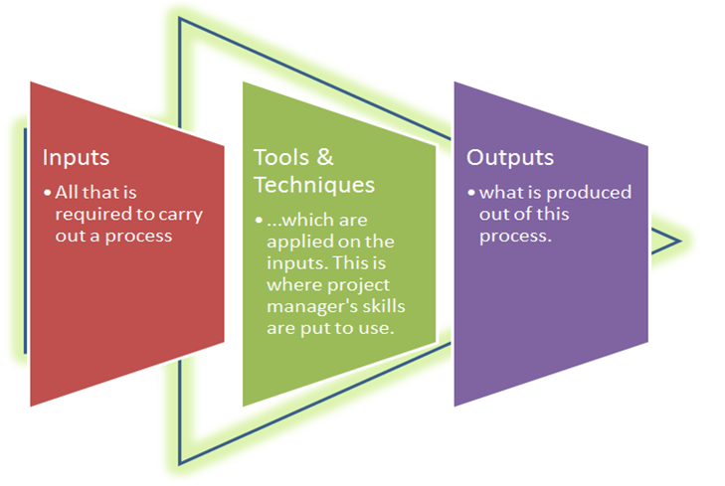
What does PMBOK contain?
Anatomy of a Process

Slide 13
What does PMBOK contain?
These processes are 49 in total (as of PMBOK-6 version).
These are grouped into 5 Process Groups – they contain activities that appear to be happening on a chronological order.
Initiating
Planning
Executing
Monitoring & Controlling
Closing
However, please bear in mind that depending on project dynamics any activity can occur at any point of time, in any sequence.

Slide 14
PMBOK Knowledge Areas
Further, the same 49 processes are grouped in another fashion – based on the knowledge it takes to execute them. This grouping is called Knowledge Areas.
There are 10 of them.
Project Integration Management
Project Scope Management
Project Time Management
Project Cost Management
Project Quality Management
Project Resource Management
Project Communications Management
Project Risk Management
Project Procurement Management
Project Stakeholder Management

Slide 15
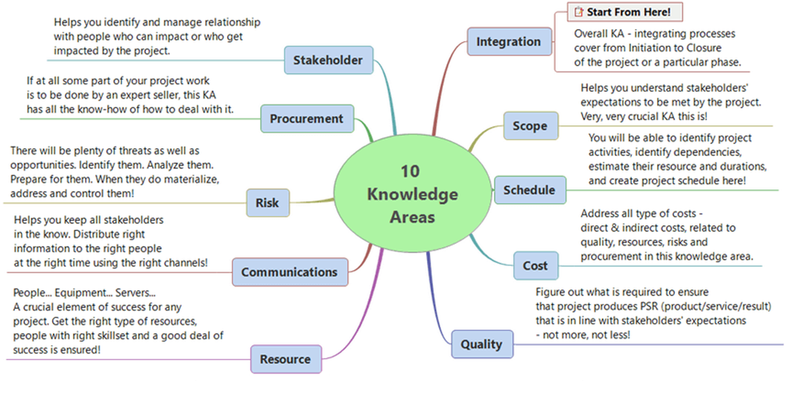
PMBOK Knowledge Areas
Understanding 10 Knowledge Areas

Slide 16
End

